Slide 1
The Andrew O’Neil Memorial Lecture
Mushrooms: For Weight Control and Health
22nd North American Mushroom Conference
June 24, 2013
Vancouver, British Columbia
Lawrence J. Cheskin, M.D.
Director, Johns Hopkins Weight Management Center
Department of Health, Behavior & Society
Johns Hopkins Bloomberg School of Public Health
Joint Appt: Medicine (GI); International Health (Human Nutrition)

Slide 2
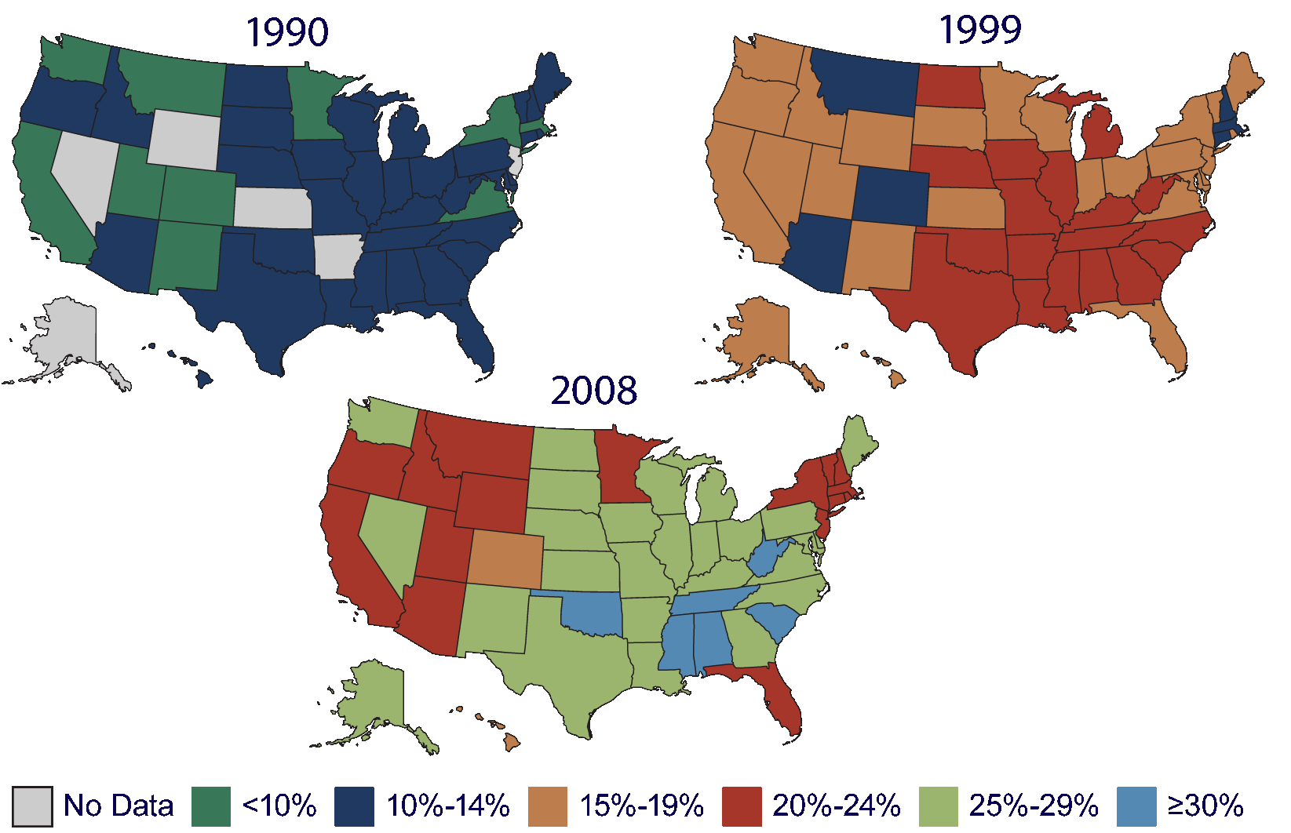
Obesity Trends* Among US Adults
BRFSS, 1990, 1999, 2008
*BMI ≥30, or about 30 lbs overweight for 5’4” person
BRFSS=Behavioral Risk Factor Surveillance System

Slide 3
Obesity in Canada
Statistics are similar to the US (slightly better)
Additional factors include:
  Generally longer, colder winters limiting physical activity
  Among native populations, a rapid “nutrition transition’ and decreased physical activity

Slide 4
Severe and Morbid Obesity Is Increasing
More Rapidly Than Mild Obesity
Normal: 18.5-24.9
Class 1 Obesity: 25-29.9 (overweight)
Class 2 Obesity: 30.0-39.9 (severe)
Class 3 Obesity: 40 or more (morbid/extreme)
Sturm, R. Public Health. 2007. July;121(7):492-496.

Slide 5
Prevalence of Extreme(Morbid) Obesity
(BMI ≥40) by Gender and Ethnicity
Flegal KM, et al. JAMA. 2010;303:235-241.

Slide 6
Approximately 25% of children and adolescents are overweight
more than any other known time in history
life expectancy
may decline
as a result

Slide 7
Life Expectancy and Obesity
Two 2009 meta-analyses determined:
  30-35 kg/m², median survival is reduced
  by 2-4 years
  40-45 kg/m² medium survival is reduced
  by 8-10 years
Prospective Studies Collaboration. Lancet. 2009;373(9669):1083-1096.
Peeters A, et al. Ann Intern Med. 2003;138:24-32.
Mason J, et al. JAMA. 2003;289:229-230.

Slide 8
How Might Obesity Shorten Lifespan?
Leading Causes of Death, North America

Slide 9
Comorbid Conditions and BMI>27 kg/m²
Common comorbid conditions in obesity
Hypertension
Dyslipidemias
Type 2 diabetes
Anderson JW, et al. Obes Res. 2001;9:S326-S334.

Slide 10
BMI and Relative Risk of Type 2 Diabetes
Adapted from Willett WC, et al. N Engl J Med. 1999;341:427-434.

Slide 11
Intentional Weight Loss (< 20 lbs) and Predicted Reduction in Mortality
Source: Williamson, D.F, et al. (1995). Am J Epidemiol 141: 1128–1141
Notes:
Note that the reduction in mortality from less common causes of death is proportionately larger than for more common conditions.

Slide 12
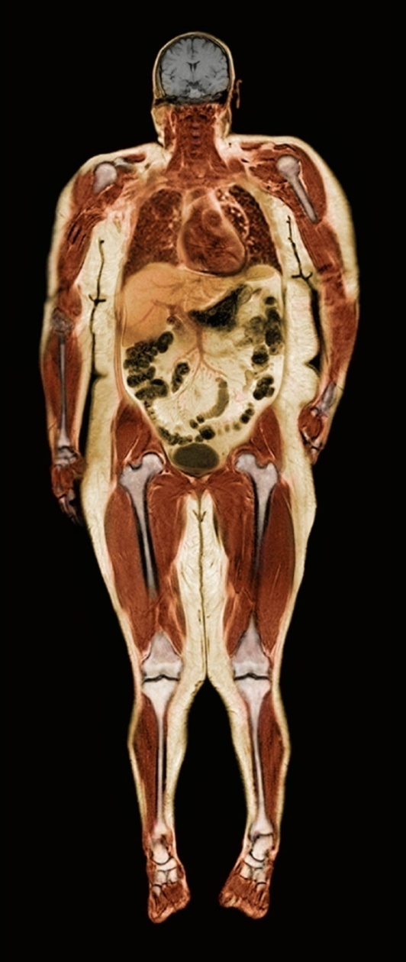
Medical Complications of Obesity
Stroke
Idiopathic intracranial hypertension
Pulmonary disease
Abnormal function
Obstructive sleep apnea
Hypoventilation syndrome
Cataracts
Coronary heart disease
Pancreatitis
Nonalcoholic fatty
liver disease
Steatosis
Steatohepatitis
Cirrhosis
Diabetes
Dyslipidemia
Hypertension
Gynecologic abnormalities
Abnormal menses
Infertility
Polycystic ovarian syndrome
Gall bladder disease
Cancer
Breast
Uterus
Cervix
Prostate
Kidney
Colon
Esophagus
Pancreas
Liver
Osteoarthritis
Skin
Phlebitis
Venous
Stasis
Gout
Notes:
13
13
Obesity is associated with complications involving many organ systems. The most common medical complications include coronary heart disease, hypertension, diabetes, dyslipidemia, liver disease, gall bladder disease, pulmonary abnormalities, and osteoarthritis. The complications associated with obesity lead to impaired quality of life, considerable morbidity, and premature death. The mechanisms responsible for many of these complications are not completely understood but probably involve the mechanical burden from excess bulk; signaling proteins produced and secreted by adipocytes; and abnormalities in lipid metabolism within adipose tissue, cardiac and skeletal muscle, and the liver and pancreas.

Slide 13
A Classification of the Obesities
Neuroendocrine Obesities
Hypothyroidism
Hypothalmic syndrome
Cushing’s syndrome
Polycystic ovary (Stein-Leventhal) syndrome
Pseudohypoparathyroidism
Hypogonadism
Growth hormone deficiency
Insulinoma and hyperinsulinism
Iatrogenic
Drugs (psychotropics, corticosteroids)
Hypothalamatic surgery
Nutritional Imbalance and Obesity
High-calorie, high-fat diets
Cafeteria diets
Physical Inactivity
Enforced (postoperative)
Aging
Job-related
Genetic (Dysmorphic) Obesities
Autosomal recessive
X-linked
Chromosomal

Slide 14
Drugs Associated with
Weight Gain
Steroids; BCPs; HRT
Tricyclic antidepressants
Phenothiazines
Lithium
Antihistamines
Sulfonylureas, insulin
Beta blockers, thiazides

Slide 15
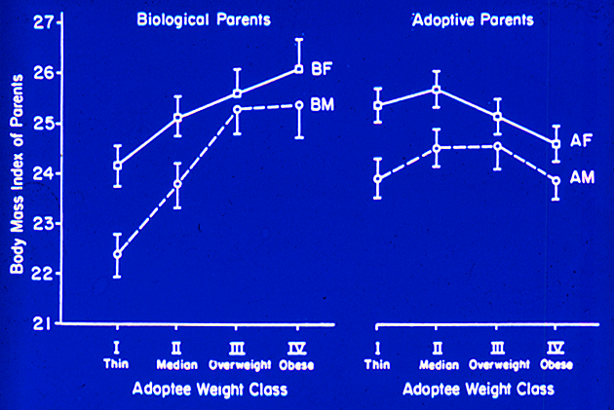
Adoption Studies
Stunkard, et al

Slide 16
Regulation of body weight
Calories consumed in 1 year:
980,000
Weight gained / year* (kcals fat):
1/2 lb (1,700)
Energy balance Error = 0.17%
*Average over 20 yrs (30-50 yrs of age, Framingham study)

Slide 17
What drives food choice?
TASTE - consumers consistently rate this as the number one reason for the food choices they make
COST - consumers look for bargains/values that taste good
CONVENIENCE - consumers want choices that simplify their lives
PROBLEM - These factors are often barriers to reducing energy intake

Slide 18
What’s Changed?....
Food Type Availability
GROWTH OF THE FAST FOOD SECTOR
YEAR | Number of Fast Food Restaurants
1980 | 1 per 2000 people
1990 | 1 per 1400 people
2000 | 1 per 1000 people
Tillotson J, Ann Rev Nutr, 2004

Slide 19
Portion size & consumption
-Portion sizes began growing in the 1970s
-Marketplace portions are now 2-8x standard serving sizes
-In children, (~ to adults), doubling portions of a lunch entrée increased entrée and total energy intakes by 25% and 15% (Orlet et al. 2003). When children were allowed to serve themselves, they consumed 25% less of the entrée than when served a large entrée portion.

Slide 20
Diet Composition and Satiety
Hierarchy of satiety (per kcal):
Fiber
Protein
Complex carbohydrates
Simple carbohydrates
Fat (unsaturated > saturated)
Ethanol
  Ethanol may even stimulate further food intake
  Liquids are less satiating than solids

Slide 21
Dietary Fat and Obesity
Epidemiologic evidence of a direct link
Calorically dense; 9 kcal/gram
Highly palatable
Efficiently stored
Virtually unlimited storage

Slide 22
Nibbling Versus Gorging
Obese individuals frequently eat fewer meals per day
Of 379 men fed 1–2 meals per day, they were heavier, had higher cholesterol, and higher glucose than those who ate more frequently
School children fed three meals per day gain more than those fed five to seven meals per day

Slide 23
The Other Side of the Energy Balance Equation: Is being sedentary a risk factor for obesity?
Few historical records of activity levels.
In USA: inverse correlation between self-reported P-act and BMI
  True for men, women, AA, Latino, white, etc.

Slide 24
WHY DO I EAT--LET ME COUNT THE WAYS
The concept of appropriate/inappropriate eating cues:
        Food as a habit
        Food as a stress reliever
        Food as a reward
        Food as a boredom reliever
        Food as a social facilitator
        Food as love
        Food as a mountain

Slide 25
Assessing Obesity in Clinical Practice
Body-mass index (BMI) = weight (kg)/height (m)²
  Normal weight: BMI 18.5-24.9
  Overweight: BMI 25.0–29.9
  Obesity: BMI 30.0-39.9
  Extreme obesity: BMI 40.0+
  BMI is positively correlated with health risk
Source: NHLBI Obesity Guidelines. Obesity Res 6(suppl 2) (1998)
Continued

Slide 26
Assessing Obesity in Clinical Practice
Waist circumference modifies the risk at any given BMI
  High risk:
    Men > 40 inches
    Women > 35 inches
Indirect measure of central adiposity, correlated with visceral fat
Excess fat in the abdomen is an independent predictor of risk factors and morbidity
Use a tape measure around widest point above umbilicus
Source: NHLBI Obesity Guidelines. Obesity Res 6(suppl 2) (1998)

Slide 27
Treatments for Obesity
Lifestyle modification
  Diet
  Physical activity
  Behavior modification
Pharmacotherapy
Surgery

Slide 28
What’s Our Best Hope for Obesity Prevention?
Change the food supply: availability, cost, advertising
Change the built environment: paths, safety
Change our schools
Change attitudes and beliefs
Serve as role models ourselves
Devote resources to research and programs
Be persistent

Slide 29

Results of Weight Loss– Medication Use
The majority of those entering the program suffered from one or more of the following conditions and required medications for control:
  Hypertension
  High cholesterol/ TG
  Type-2 diabetes

Slide 30

As a result of weight loss…
Hypertension ↓
  57% reduced or stopped HTN meds
    While achieving normal BP values
High cholesterol ↓
  55% stopped taking “statin” medication
    And achieved normal cholesterol & TG values
Type-2 diabetes ↓
  50% reduced or stopped medications, including insulin and oral agents with improvements in fasting blood glucose / HbA1c
    This effect often occurs quite early in the course of wt loss

Slide 31
As a result of weight loss…
Decreased need for medications or treatment for:
  Arthritis / pain control
  Gastroesophageal reflux disease (GERD)
  Obstructive sleep apnea (off CPAP)
  Angina pectoris
  Non-alcoholic fatty liver disease (NAFLD)

Slide 32

Other Common Outcomes
Lower cost of health care
Improved health-related quality of life
Improved mood & self-esteem
Improved fertility
Better sleep
More energy
Decreased fatigue

Slide 33
Dietary Control of Obesity
The substitution of low calorie foods for high-calorie foods has been proposed as a means of preventing, or reversing obesity…

Slide 34
Why Mushrooms?
Nutritional value
Nutritional composition
Satiety value
Substitution potential for high fat, high energy density foods
  The Evidence…

Slide 35
But will it work?
What is compensation?
An increase in caloric intake following a meal that is of lower energy.
(“making up for lost calories”)

Slide 36
Background – Compensation
Sometimes there is compensation –
e.g., after drinking diet soda vs regular
Sometimes not –
only partial compensation eating a less-dense meal (low-fat cream cheese on bagels) following a week of energy-rich meals (regular cream cheese)
Differences in % compensation by age, gender, BMI:
  Young males exhibit more complete compensation than females and older adults (Rolls 1998)
  Obese individuals generally have been found to compensate more poorly than lean (Rolls 1994, Roe 1999)

Slide 37
Our recent work on mushrooms & weight control:
Mushroom Council sponsored
The first study to examine whether replacing one food for an entirely different one (meat vs. mushrooms) would lower overall calorie intake, and be as filling as higher calorie foods.

Slide 38
Methods
Controlled intervention study, crossover design with each subject serving as his or her own control.
Healthy men and women, aged 18-65
18 men and 36 women
  normal weight (43%),
  overweight (33%),
  obese (24%)
  received 4 days of lunchtime meat entrées,
  followed by 4 days of the same entrées substituted with mushrooms.

Slide 39
Methods
Daily Measures:
Pre-meal hunger was recorded.
Food was weighed before and after the meal was eaten.
Satiety every hour for 5 hours after lunch
Recording of all daily food, beverages and physical activity.

Slide 40
Methods
First Group Schedule:
Day: 1 2 3 4 5 6 7 8 9 10 11
Washout
Washout
Washout
Second Group Schedule:
Day: 1 2 3 4 5 6 7 8 9 10 11
Washout
Washout
Washout

Slide 41
Calories: 783 meat, 339 mushroom dishes;
Potential savings= 444 calories/day

Slide 42
Fat grams per serving

Slide 43
MUSHROOM LASAGNE
INGREDIENTS
8 strips Rippled Edged Lasagne Noodles 4 tbs. Butter or Margarine 8 oz. Mozzarella Cheese, thinly sliced 1/2 tsp. Salt 1/2 cup Parmesan Cheese, grated 2 lbs. Fresh White Mushrooms 3 -8oz. cans Tomato Sauce 12 oz. Ricotta or Cottage Cheese 1/8 tsp. Ground Black Pepper
DIRECTIONS
Cook noodles following package directions; drain and set aside. Rinse, pat dry and slice mushrooms (makes about 10 cups). In large skillet heat butter; add mushrooms and sauté for 5 minutes. Drain off any mushroom liquid. Butter a 12 x 9-x 2-inch casserole. Cover bottom with 1 can of the tomato sauce. Top with 4 strips of the cooked noodles, overlapping edges slightly. Arrange half of the Mozzarella over the noodles and spoon half of the mushrooms over the cheese. Combine 1 can of the tomato sauce with Ricotta Cheese, salt and black pepper. Spoon half of the cheese and tomato mixture over the mushrooms. Sprinkle with half of the Parmesan cheese. Repeat. Place in a preheated moderate over (350 deg.) for 30 minutes or until bubbly. Let stand 10 minutes before serving.
YIELD: 6 Portions

Slide 44
Results
There was no change in ratings of hunger, satiety, or palatability between meat and mushroom entrees
Hunger
Post-meal Fullness
General Sense of Fullness
Ease of Control Over Eating
Cravings For Foods
Urgency to Eat

Slide 45
Average Daily Consumption, Meat vs Mushroom weeks
(n=54 adults) | Meat Week | Mushroom Wk | Difference | P-Value
Calories | 2014 | 1635 | 385/444 | 0.000
Fat (grams;% of total intake) | 88.4 (40%) | 60.0 (33%) | 28.4 | 0.000
Saturated Fat (grams) | 21.5 | 18.7 | 2.8 | 0.099
Carbohydrates (grams) | 201 | 206 | 5 | Not significant
Fiber (grams) | 16 (3.195%) | 18 (4.37%) | 1.77 | 0.207
Protein (grams;% of total intake) | 105 (21%) | 68 (17%) | 37 | 0.000

Slide 46

Overall Results
Total daily energy intake was significantly greater in the meat condition (2014 kcal) than in the mushrooms (1635 kcal)
Undercompensation for Fat and Calories:
Calorie compensation was 14%
Fat compensation was 7%
Saturated fat compensation was 50%
Protein compensation was 10%
Carbohydrate compensation was 100%

Slide 47
Duration of Results
No compensation for the caloric reduction by eating more or exercising less
  either later that day (short-term)
  or over 4 days (intermediate term)

Slide 48
Benefit for weight control?
Lean individuals compensated for the calories saved during the mushroom week more than overweight and obese individuals
When adjusted for exercise, lean people compensate even more, but overweight and obese do not (thus lean people will not lose significant weight from eating mushrooms)
Therefore, overweight or obese people will benefit the most from substituting mushrooms for meat.
Lean | Overweight | Obese
n = 23 | n = 18 | n = 13
23% Caloric Compensation | 6.3% Caloric Compensation | 1.1% Caloric Compensation

Slide 49
Conclusion: These results strongly suggest that the substitution of low ED mushroom foods for high ED foods such as beef, in otherwise similar recipes, can be an effective method for reducing daily energy intake.

Slide 50
Implications:
Do these savings in calories persist beyond a week?
(Encouraging in this was that the degree of energy compensation did not appear to increase from day 1 to day 4 of the mushroom substitution, nor was there compensation over the weekend between mushroom and meat weeks. )
Based on the above findings, the effect of consuming a single mushroom-substituted meal 4x/week would be to lose 20 lbs in a year.
These projections were tested in a long-term study

Slide 51
Inflammation and Mushrooms
Weight loss in obese individuals is accompanied by decreases in measures of oxidative stress and inflammation
These changes have also been demonstrated in the laboratory with mushroom use, as have favorable changes in immune function
There was the opportunity to design a weight control trial that involved increased consumption of mushrooms which could assess both the efficacy for weight control, and anti-inflammation

Slide 52
Follow-up study:
Built on the experimental results above to perform a controlled, but naturalistic study of the longer-term effect on body weight, weight maintenance, and appetite of mushroom substitution for high ED foods like meats
Added measures to assess the synergistic effects of mushroom consumption on levels of oxidative stress/ inflammation
Inclusion of an active weight loss control group (retested after initial weight loss) that does not use mushrooms allowed separation of these 2 effects (weight loss and anti-inflammation)

Slide 53
Follow-up study design:
Study Design: Randomized, controlled, parallel group, 1-year clinical weight-control trial.
Population: Mushroom-eating adult men and women, overweight or obese (BMI 25-40), seeking weight loss
n = 80 adults (based on previous weight loss studies showing that wt loss was 3 x as great on low ED (low fat, high fiber) diets.

Slide 54
Follow-up study design:
After baseline measurements and biochemical tests…
Both groups (mushroom and control) were prescribed a 500 kcal/d energy-deficit diet designed to achieve ~20 lbs weight loss over the first 6 months.
The mushroom group only was also instructed and monitored in the preparation and use of mushroom substitutes for meat provided with mushrooms, an inexpensive food processor, and measuring cups, instructed to use a cup of mushrooms at least 3 meals/wk.
All weights and measures were repeated after initial wt loss.
For the second 6 months of the 1-yr intervention, all participants were prescribed a weight-maintenance diet.
The mushroom group continued using mushrooms.
Food and physical activity logs were completed periodically to describe changes in consumption patterns.

Slide 55
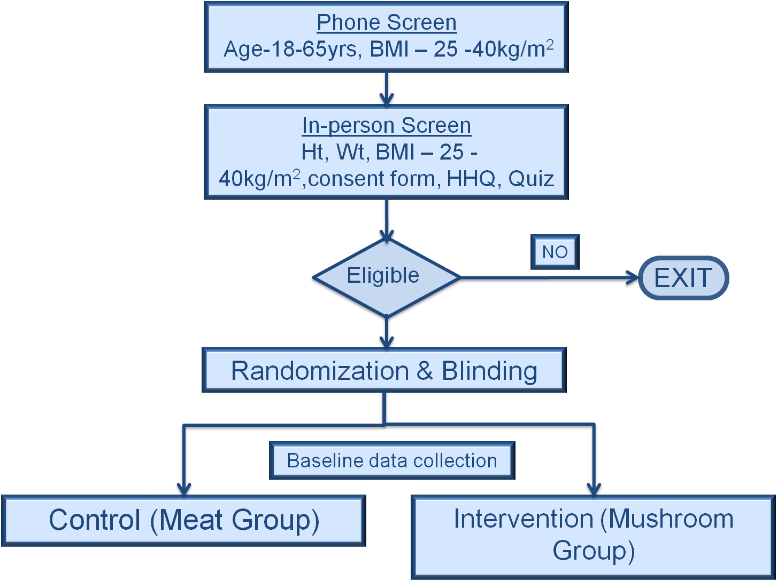
Follow-up study design:
BASELINE DATA COLLECTION:
Anthropometric measures - body weight, BMI, waist circumference, total percent body fat measures
Blood Collection for biochemical measures – Blood glucose, lipid panel, IL-6, CRP and oxd LDL
Food Records – 7 day food records

Slide 56
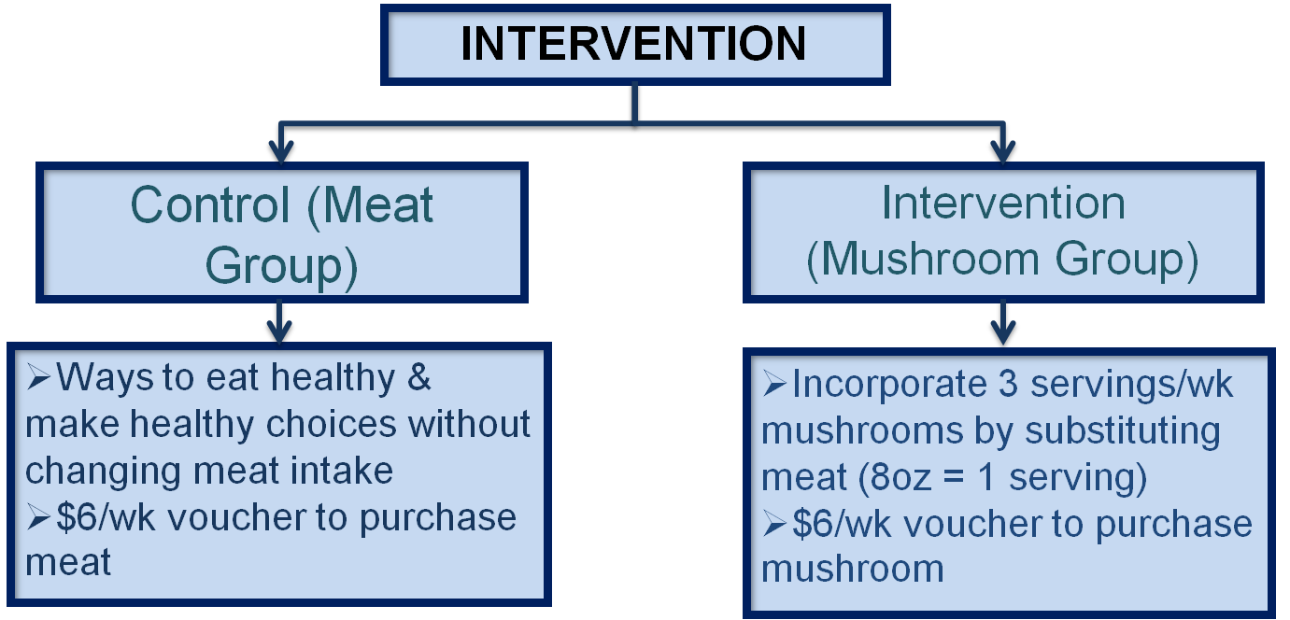
Follow-up study: Intervention
The mushroom group only was instructed and monitored in the preparation and use of mushroom substitutes for meat and other high ED foods, provided with recipes to incorporate mushrooms in their diet

Slide 57
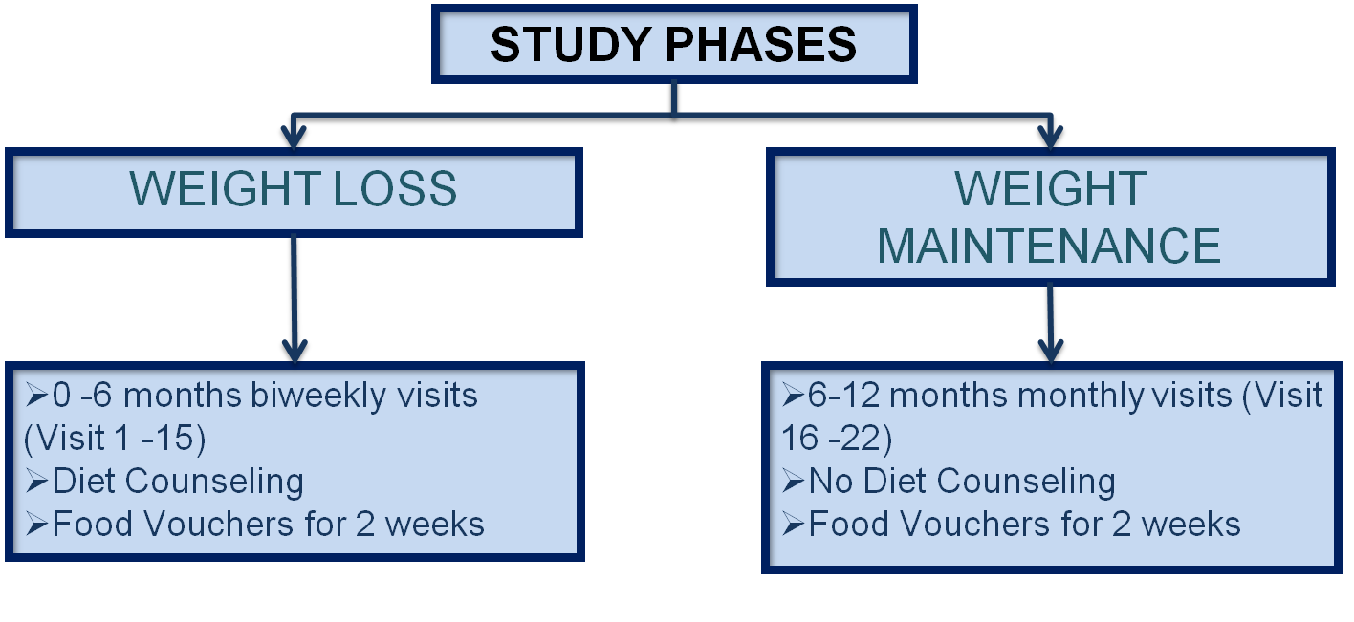
Follow-up study: Phases
Weight loss phase :- Both groups (mushroom and control) were prescribed a 500 kcal/d energy-deficit diet over the first 6 months of the intervention .
Weight maintenance phase:- For the second 6 months of the 1-yr intervention, all participants were prescribed a weight-maintenance diet in the mushroom group. The mushroom group continued using mushrooms in their diet.

Slide 58
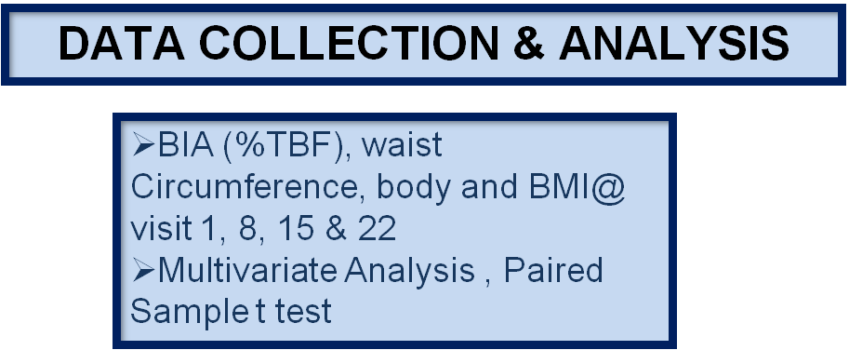
Follow-up study: Data Collection and Analysis
After baseline measurements and biochemical tests at Visit 1…
All the measures & biochemical tests were repeated at Visits 8, 15 & 22
Food and physical activity logs were completed at these visits to describe changes in consumption patterns.
In addition to this, at every visit participants were asked to complete a questionnaire to assess their compliance with mushroom intake
Multivariate analysis of variance and paired sample t-test was used to analyze the data

Slide 59

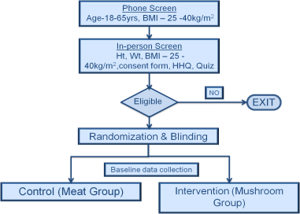
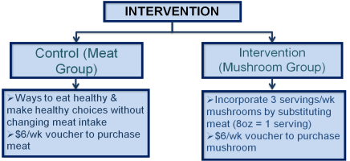
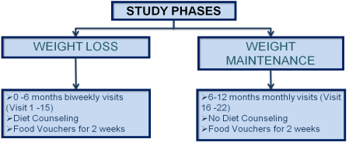
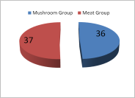
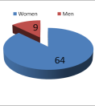
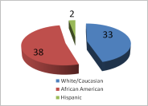
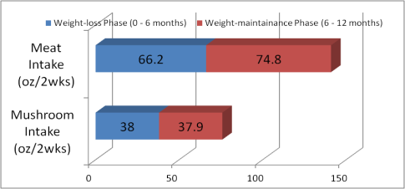
Positive effect of white button mushrooms when substituted for meat on body weight and composition changes during weight loss and weight maintenance – A one-year randomized clinical trial.
Kavita H. Poddar, PhD,RD¹; Meghan Ames, MSPH, RD¹; Hsin-Jen Chen²,
Mary-Jo Feeney, MS, RD³; Youfa Wang, MD, PhD²; Lawrence J. Cheskin, MD¹
¹Department of Health Behavior and Society, Johns Hopkins Bloomberg School of Public Health, Baltimore, MD 21205
²Department of International Health, Johns Hopkins Bloomberg School of Public Health, Baltimore, MD 21205
³Consultant to Food and Agricultural Industries, Los Altos, CA 94024 USA
Program No. 852.4
INTRODUCTION
Screening and Randomization
MACRONUTRIENT INTAKE
DISCUSSION
In the United States, weight gain and subsequent development of obesity is reaching epidemic proportions across race, gender and age groups and can be attributed to positive energy balance (1, 2).
American diets are high in fat and energy density making passive overconsumption of energy inevitable, leading to weight gain and obesity (3,4).
Concomitantly, the consumption of red and processed meats has risen significantly in the US, & are associated with high saturated fat and cholesterol making it one of the major contributor of high energy dense food (5).
Substituting high energy dense foods with low energy dense foods is one obvious strategy to lose weight and improve body composition while providing high nutrient quality & satiety(6).
One study showed that substituting edible mushrooms for meat in the diets of participants lowered total short-term energy intake by nearly 20% in normal, overweight and obese individuals (7).
Current study assesses weight loss and weight maintenance efficacy with white button mushrooms as a substitute for meat over a period of one year & builds on the experimental results of the short-term study described above
Table 1: Estimated marginal mean change in macronutrient and fiber intake from baseline to endpoint for participants in the Meat Vs. Mushroom group ª
Variable | Meat Diet (n=17) | Mushroom Diet (n=17) | P Value
Baseline to the end of weight maintenance (0 - 12 months)
Total average calorie intake (kcals/day)ª | 132.48 ± 94.99 | -122.69 ± 112.87 |  | 0.092
Total average carbohydrate intake (g/day) ª | 36.03 ± 11.27 | -7.65 ± 13.39 |  | 0.017*
Total average protein intake (g/day) ª | -8.01 ± 5.24 | -13.09 ± 6.22 |  | 0.535
Total average fat intake (g/day) ª | 2.17 ± 5.79 | -4.25 ± 6.88 |  | 0.480
Total average fiber intake (g/day) ª | 0.16 ± 1.10 | -1.09 ± 1.30 |  | 0.468
ªMultivariate analysis of variance; P<0.05; means expressed as estimated marginal mean±standard error (SE); Significant at P<0.05*.
Paverage of 2.2 pounds, or 1.1% of starting weight was lost .
Waist circumference decreased in individuals on the mushroom diet -- a clinically significant mean of 2 inches during the 6-month weight loss phase compared to 1 inch in standard diet
Following initial weight loss, those who followed mushroom-rich diet, maintained their weight loss and lost an additional 0.5 inches in waist circumference versus those following the standard diet gained an average of almost 5 inches in waist circumference
At the end of 12-month study participants on mushroom rich diet weighed a mean of 7 lbs less, had lowered mean BMI by 1.5 kg/m², lowered mean waist circumference by 2.5 inches, and lowered mean percent body fat by 0.8% compared to baseline
Overconsumption of energy-dense foods high in fat are associated with overweight status(7) & current results support previous findings
Individuals who followed the mushroom-substituted diet pattern had lower energy & fat intake versus those who followed standard diet
nts in mushroom diet lost an average of 7.0 pounds, or 3.6% of their
articipastarting weight compared to participants in standard diet where
INTERVENTION, STUDY PHASES & DATA COLLECTION
CONCLUSION
Treatment with mushrooms was associated with high satiety without compromising palatability (7) and current results support the potential utility of mushrooms as a low calorie substitute for red meat in overweight or obese
This substitution can help to reduce total energy and fat intake
The more general strategy of substituting low energy-density foods for energy-dense foods will prove to be an effective method for promoting weight loss and body composition improvement
BODY COMPOSITION CHANGES
OBJECTIVES
Table 2: Between group (meat vs. mushroom) differences in mean weight, waist circumference, percent body fat and BMI changes for participants at the end of weight loss and weight maintenance phases ^{a,b,c}.
Variable | Meat Diet (n=37) |  | Mushroom Diet (n=36) | P value
Weight loss phase ( 0 – 6 months)
Body Weight (lbs)ª |  | -2.21±3.11 | -7.02±3.15 | 0.281
BMI (kg/m²) ª |  | -1.04±0.76 | -2.33±0.77 | 0.233
Waist circ. (inch)ª |  | -1.41±0.36 | -2.04±0.37 | 0.226
Percent total body fat (%)ª |  | -0.49±0.99 | -1.65±1.01 | 0.416
Weight maintenance phase (6 - 12 months)
Body weight (lbs)^{b} |  | -0.74±1.12 | -0.01±1.12 | 0.646
BMI (kg/m²)^{b} |  | -0.08±0.79 | 0.81±0.79 | 0.430
Waist circ. (inch)^{b} |  | 4.74±3.51 | -0.54±3.51 | 0.292
Percent total body fat^{b} |  | -0.69±0.99 | 0.80±0.99 | 0.287
Weight-loss from baseline to the end of 1 yr (0 - 12 months)
Body weight (lbs)^{c} |  | -2.20±3.29 | -7.03±3.34 | 0.307
BMI (kg/m²)^{c} |  | -1.00±0.36 | -1.53±0.36 | 0.308
Waist circ. (inch)^{c} |  | 3.32±3.42 | -2.58±3.47 | 0.230
Percent total body fat^{c} |  | -1.01±0.52 | -0.85±0.53 | 0.823
ªMultivariate analysis of variance; P<0.05; means expressed as estimated marginal mean±standard error (SE); Analysis includes first 6 months of intervention (weight loss phase). ^{b}Multivariate analysis of variance; P<0.05; means expressed as estimated marginal mean±standard error (SE); Analysis includes second 6 months of intervention (weight maintenance phase). ^{c}Multivariate analysis of variance; P<0.05; means expressed as estimated marginal mean±standard error (SE); Analysis includes baseline 0 months of intervention to end of the weight maintenance phase 12 months.
To assess body weight changes at the end of weight loss and weight maintenance phase
To assess BMI, total percent body fat & waist circumference changes at the end of weight loss and weight maintenance phase
To assess macronutrient intake of the participants in the mushroom versus meat diet group at the end of weight loss and weight-maintenance phases of the study
REFERENCES
SUBJECTS AND METHODS
RESULTS
Flegal, K. M., Carroll, M. D., Ogden, C. L., & Curtin, L. R. (2010). Prevalence and trends in obesity among US adults, 1999–2008. JAMA, 303(3), 235–41.
Ogden, C. L., Carroll, M. D., Curtin, L. R., Lamb, M. M., & Flegal, K. M. (2010). Prevalence of high body mass index in US children and adolescents, 2007–2008. JAMA, 303(3), 242–9.
Prentice, A., & Jebb, S. (2004). Energy intake/physical activity interactions in the homeostasis of body weight regulation. Nutr Rev, 2004, 62, S98-104.
Ershow, A.G. (2009). Environmental influences on development of type 2 diabetes and obesity: challenges in personalizing prevention and management. J Diabetes Sci Technol, 3, 727-34.
Wang, Y., Beydoun, M. A., Caballero, B., Gary, T. L., & Lawrence, R. (2010). Trends and correlates in meat consumption patterns in the US adult population. Public Health Nutr, 13(9), 1333-45.
Wang, Y., Beydoun, M. A. (2009). Meat consumption is associated with obesity and central obesity among US adults..Int J Obes, 33(6), 621-8.
Cheskin, L. J., Davis, L. M., Lipsky, L. M., Mitola, A. H., Lycan, T., Mitchell, V., et al. (2008). Lack of energy compensation over 4 days when white button mushrooms are substituted for beef. Appetite, 51, 50-57.
The study protocol was approved by the Institutional Review Board at the Johns Hopkins University, Bloomberg School of Public Health.
This was a single blinded randomized clinical trial
The study enrolled 209 overweight/obese (BMI 25-40) adult male & female participants who reported a desire to lose weight. Final analysis included 74 participants, for a drop-out rate of 65% after 12 months
RECRUITMENT
Advertisements through the local newspaper (Baltimore Sun, City Paper), flyers posted around the campus and at local sites (supermarket bulletin boards)

Slide 60
Results of Long-Term Study
Those on the mushroom diet lost an average of 7.0 pounds, or 3.6% of their starting weight ; those on the standard diet lost an average of 2.2 pounds, or 1.1% of starting weight
Waist circumference decreased on the mushroom diet -- a clinically significant mean of 2 inches during the 6-month weight loss phase compared to 1 inch on the standard diet
Following initial weight loss, those who followed the mushroom-rich diet maintained their weight loss and lost an additional 0.5 inches in waist circumference versus those following the standard diet who gained an average of almost 5 inches in waist circumference
At the end of 12-month study, those on the mushroom-rich diet weighed a mean of 7 lbs less, had lowered mean BMI by 1.5 kg/m², lowered mean waist circumference by 2.5 inches, and lowered mean percent body fat by 0.8% compared to baseline
Individuals who followed the mushroom-substituted diet pattern had lower energy & fat intake versus those who followed the standard diet

Slide 61

Results of Long-Term Study

Slide 62
Baseline Macronutrient Content
Variable | Baseline intake (Meat) | Baseline intake (Mushroom) | P Value (NS = not significant)
Total average calorie intake (kcals/day)ª | 1398.44±107.36 | 1513.34±107.36 | NS
Total average carbohydrate intake (g/day) ª | 152.25±12.71 | 172.40±12.71 | NS
Total average protein intake (g/day) ª | 69.00±5.40 | 69.03±6.12 | NS
Total average fat intake (g/day) ª | 59.09±5.77 | 62.82±5.77 | NS
ªMultivariate analysis of variance; means expressed as estimated marginal mean ± standard error (SE)

Slide 63
Changes in Dietary Macronutrients
Mean change in macronutrient and fiber intake from baseline to endpoint for participants in the Meat Vs. Mushroom group ª
Variable | Meat Diet (n=17) | Mushroom Diet (n=17) | P Value
Baseline to the end of weight maintenance (0 - 12 months)
Total average calorie intake (kcals/day)ª | 132.48 ± 94.99 | -122.69 ± 112.87 | 0.092
Total average carbohydrate intake (g/day) ª | 36.03 ± 11.27 | -7.65 ± 13.39 | 0.017*
Total average protein intake (g/day) ª | -8.01 ± 5.24 | -13.09 ± 6.22 | 0.535
Total average fat intake (g/day) ª | 2.17 ± 5.79 | -4.25 ± 6.88 | 0.480
Total average fiber intake (g/day) ª | 0.16 ± 1.10 | -1.09 ± 1.30 | 0.468
ªMultivariate analysis of variance; P<0.05; means expressed as estimated marginal mean±standard error (SE); Significant at P<0.05*.

Slide 64
Changes in Body Composition
Between group (meat vs. mushroom) differences in weight, waist circumference, % body fat and BMI at the end of weight loss and weight maintenance phases ^{a,b,c}.
Variable | Meat Diet (n=37) | Mushroom Diet (n=36) | P value
Weight loss phase ( 0 – 6 months)
Body Weight (lbs)ª | -2.21±3.11 | -7.02±3.15 | 0.281
BMI (kg/m²) ª | -1.04±0.76 | -2.33±0.77 | 0.233
Waist circ. (inch)ª | -1.41±0.36 | -2.04±0.37 | 0.226
Percent total body fat (%)ª | -0.49±0.99 | -1.65±1.01 | 0.416
Weight maintenance phase (6 - 12 months)
Body weight (lbs)^{b} | -0.74±1.12 | -0.01±1.12 | 0.646
BMI (kg/m²)^{b} | -0.08±0.79 | 0.81±0.79 | 0.430
Waist circ. (inch)^{b} | 4.74±3.51 | -0.54±3.51 | 0.292
Percent total body fat^{b} | -0.69±0.99 | 0.80±0.99 | 0.287
Weight-loss from baseline to the end of 1 yr (0 - 12 months)
Body weight (lbs)^{c} | -2.20±3.29 | -7.03±3.34 | 0.307
BMI (kg/m²)^{c} | -1.00±0.36 | -1.53±0.36 | 0.308
Waist circ. (inch)^{c} | 3.32±3.42 | -2.58±3.47 | 0.230
Percent total body fat^{c} | -1.01±0.52 | -0.85±0.53 | 0.823
ªMultivariate analysis of variance; P<0.05; means expressed as estimated marginal mean±standard error (SE); Analysis includes first 6 months of intervention (weight loss phase). ^{b}Multivariate analysis of variance; P<0.05; means expressed as estimated marginal mean±standard error (SE); Analysis includes second 6 months of intervention (weight maintenance phase). ^{c}Multivariate analysis of variance; P<0.05; means expressed as estimated marginal mean±standard error (SE); Analysis includes baseline 0 months of intervention to end of the weight maintenance phase 12 months.

Slide 65
Conclusions
Participants following a mushroom-rich diet lost an average of 7.0 pounds, or 3.6% of their starting weight, compared to the standard diet where average loss was 2.2 pounds, or 1.1% of starting weight
Waist circumference decreased in individuals on the mushroom diet -- a clinically significant mean of 2 inches during the 6-month weight loss phase, compared to 1 inch on the standard diet
Following initial weight loss, those who followed the mushroom-rich diet maintained their weight loss, and lost an additional 0.5 in waist circumference; those on the standard diet gained an average of almost 5 inches in waist circumference
At the end of our 12-month study, those on the mushroom rich diet weighed a mean of 7 lbs less, had lowered mean BMI by 1.5 kg/m², lowered mean waist circumference by 2.5 inches, and lowered mean percent body fat by 0.8% compared to baseline
It was known that consumption of energy-dense foods high in fat is associated with overweight. The current study also finds poorer results when attempting weight loss
Individuals who followed the mushroom-substituted diet pattern had lower energy & fat intake, and better success at losing weight and maintaining that loss

Slide 66
Take-Home Message
The work you are engaged in every day has the power to help combat an important and pervasive social issue: obesity

Slide 67
Thank you!

